Slide 1

SuSy efiport’s Online
Submission System
3 December 2021
Notes:
Hello! My name is Ruby Salvatore.
I’m the Business Development Manager at efiport GmbH. efiport is eLearning and EdTech company devoted to being a research and development partner for our customers. We offer content development and Managed Training Services as well as software solutions in an organisational learning and university context.

Slide 2


Notes:
Today I’d like to talk about something that many of you have probably gone through (maybe even more than once) - I want to talk about Do you remember the thesis process – that final hurdle before graduation?
If you do remember it, you probably remember it with discomfort, joy, relief, anxiety, excitement or any mix of those emotions.
I’m sure this might have been for a number of reasons – from doing the research, gathering your data and processing it, to writing the thesis, scrambling to meet the deadlines, coordinating with your group members, waiting for your results. Writing a thesis can be overwhelming.
But there’s another element to this whole process that’s stressful.
You’ve probably forgotten about it, because the rest was so overwhelming. I’m talking about the administrative and organisational aspect of proposing, registering, and handing in your thesis. We strongly believe that if this part of the process were improved, it might give a different perspective to the students who go through the experience.

Slide 3

Writing a thesis is a critical milestone in completing a degree.
The thesis writing process has always been highly administrative.
Organising students
Negotiations with students & professors
Emails
Phone calls
Many stakeholders
Notes:
But there’s another element to this whole process that’s stressful.
You’ve probably forgotten about it, because the rest was so overwhelming. I’m talking about the administrative and organisational aspect of proposing, registering, and handing in your thesis. We strongly believe that if this part of the process were improved, it might give a different perspective to the students who go through the experience.
In our conversations with our partners and customers, we found out that the thesis writing and submission process is very administrative and involves a lot of moving parts. It involves the admins or study advisors, professors, and students – and there’s a lot of communication, negotiation, and organisation involved.
Most of the time, this happens through emails and phone calls, and registration and submission takes place in paper form. Especially considering the current situation, a digitial solution is critical.

Slide 4
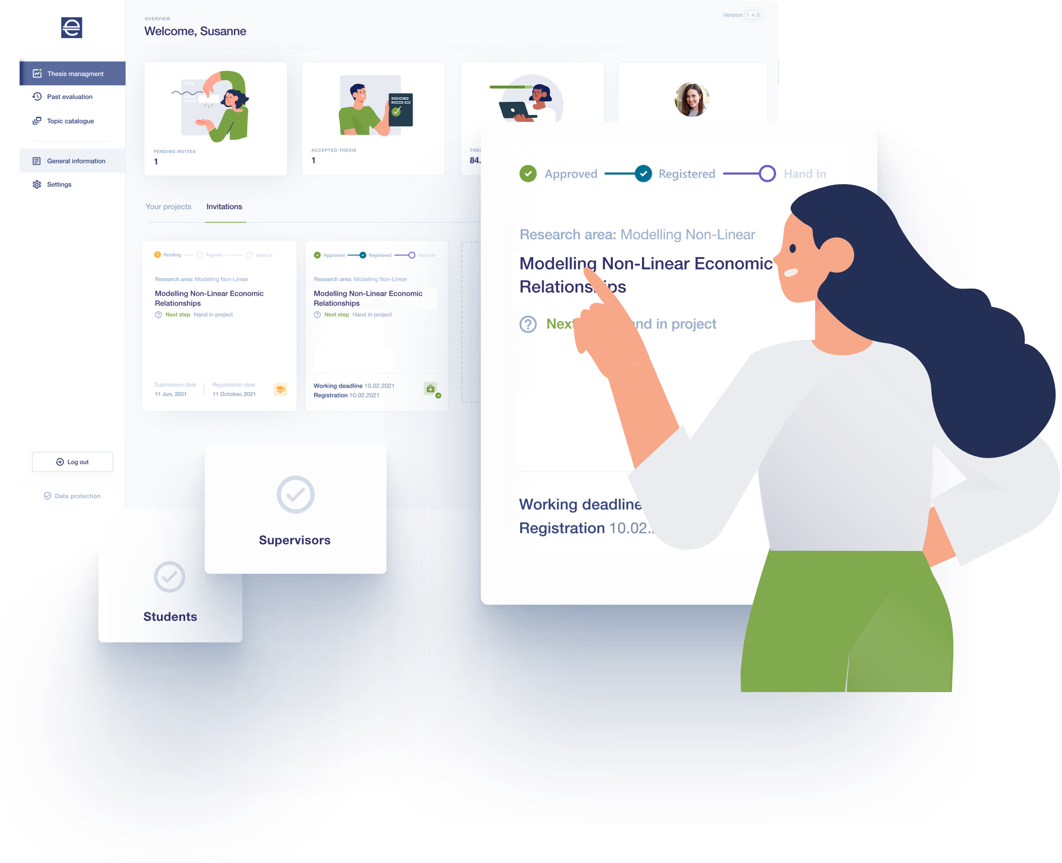
SuSy: your online submission system
Notes:
efiport has developed an online solution for the thesis process. We call it SuSy, for Submission System.
So who, or what, is SuSy?
SuSy is a thesis submission system that enables everyone - admins, professors, and students - to complete the entire process online.

Slide 5







SuSy: your online submission system
Easy management of the thesis process for students, supervisors, and administrators
Aggregate results for QM & accreditation
Propose thesis projects
Receive approval
Upload final results
Find a supervisor
Formally communicate & provide feedback
Evaluate thesis
Notes:
The thesis process has a lot of steps, but SuSy helps everyone through them.
SuSy helps students find and propose a topic for their thesis.
It recommends a supervisor based on their choice of topic and allows them to communicate and receive feedback.
Supervisors can then review proposals and accept, decline, or ask for more information.
Then – students start the real work – writing the thesis.
But once they’re done, they can upload their results in SuSy for review.
Supervisors review and evaluate the submissions and grade and give feedback.
All of this comes together to make sure your institution has the data and insight you need for quality management and accreditation.

Slide 6
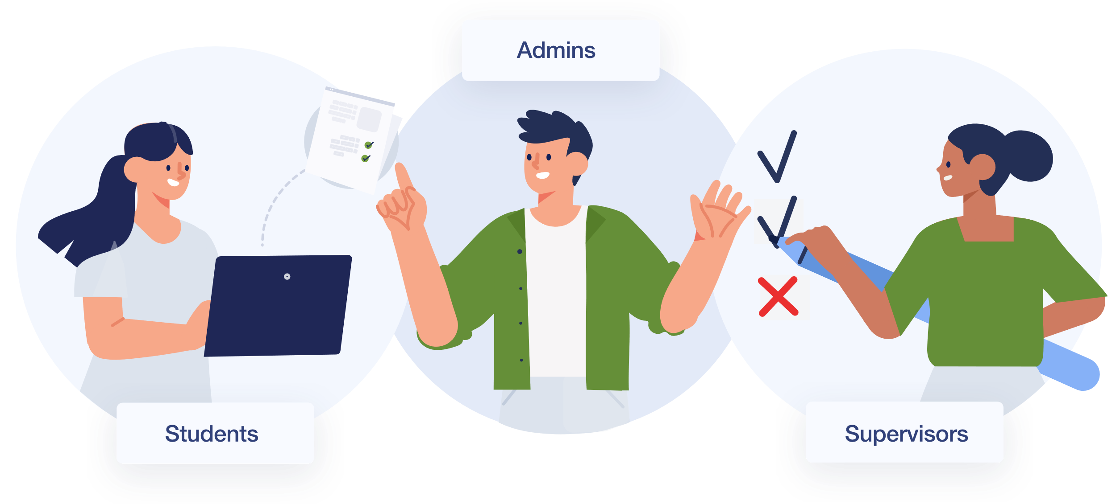
How SuSy helps your users
Notes:
There are three roles in SuSy:
Bachelor and Master students who have to propose and submit their thesis to graduate
Supervisors who are internal faculty members and externals who supervise and evaluate theses
Admins who are study advisors and programme managers who support and guide students

Slide 7






Browse existing topics or suggest your own
Keep an overview of the process and deadlines
Find the right supervisor faster with SuSy
Focus on preparing your thesis
Get feedback and answers directly in the system
Notes:
For students, writing their thesis is a stressful time. They’re thinking about their topic and research, which sources to include, which professor to pick, will their proposal be accepted? In all of this, it’s easy to forget deadlines or where to find the writing guidelines. They’re worried about the content and don’t have time to focus on the administrative stuff.
With SuSy, students can browse through a topic catalogue and view published topics from professors. This makes it easier to find the right topic and select the right supervisor. They’re guided through submitting their proposal and can receive direct feedback from supervisors.
The dashboard shows the current status and progress of their projects and any upcoming steps.
SuSy makes sure students always know where they are in the process, what the next step is, what guidelines they have to follow, and when any upcoming deadlines are. It helps them coordinate with group members, supervisors, and admins.
SuSy handles the administration and helps students stay on top of things so that they can focus on writing their thesis.

Slide 8

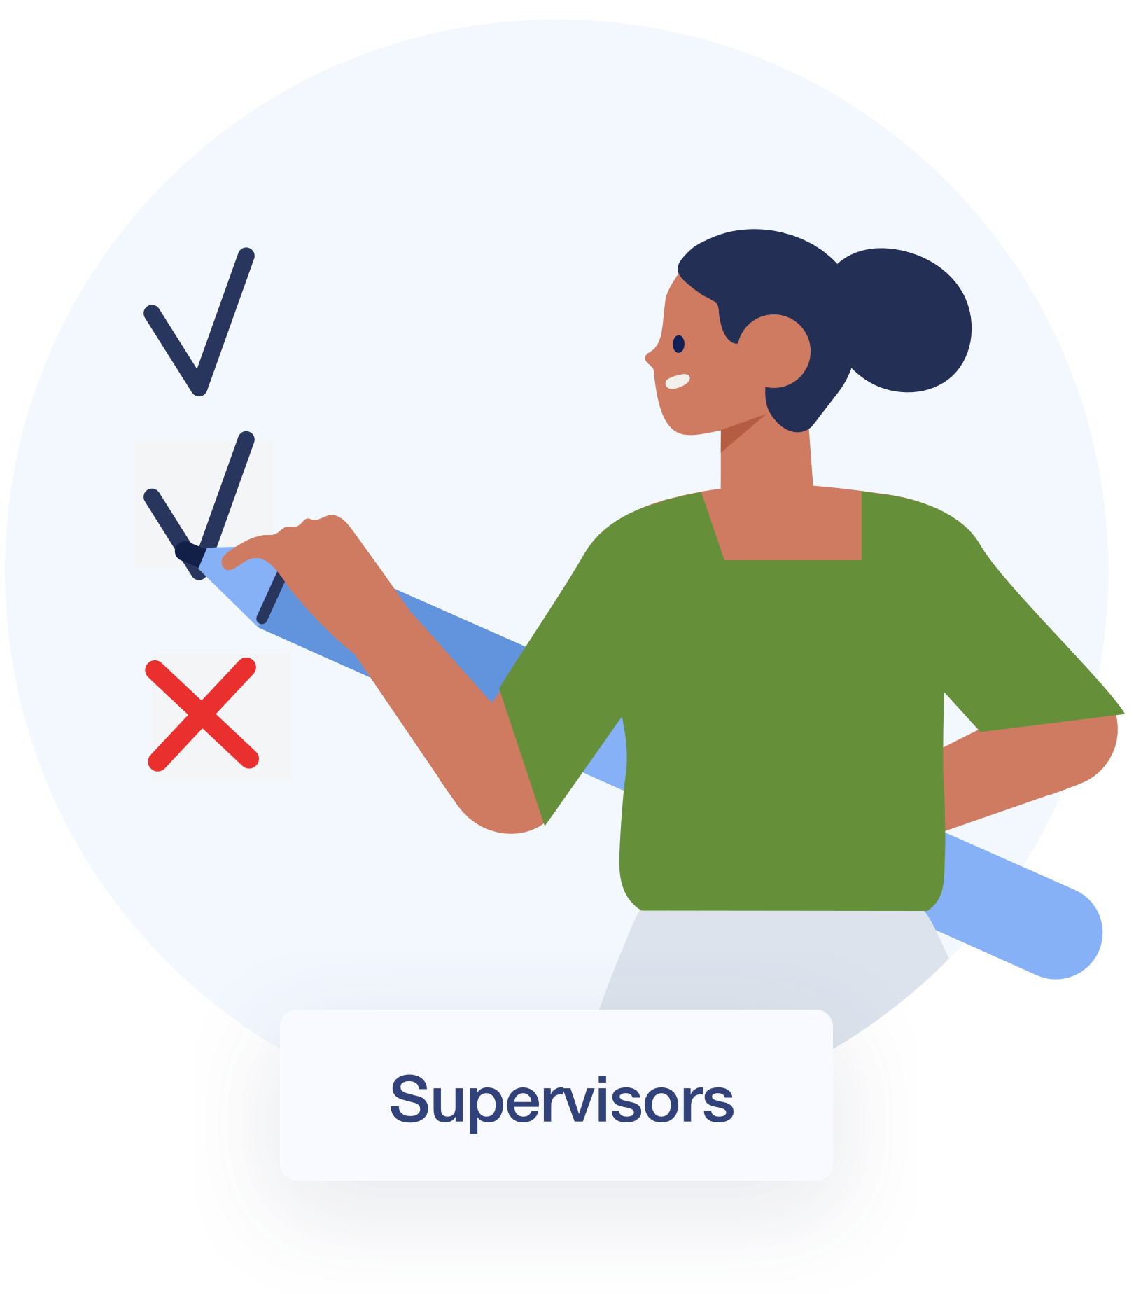

Get the overview of current projects, upcoming deadlines and overall capacity
Real-time status updates on existing projects and incoming requests
Manage all thesis paperwork in one place
Notes:
In conversations with supervisors and professors, we found out they have topics they’d like to mentor and need a way to make them available to students for their proposals. Currently, this is often an error-prone manual process – lists are provided in emails or excel tables or printed out and hung in front of the library.
We also learned that professors supervise a lot of theses, and it can be hard to keep track of the deadlines, the next steps, the different requirements for each programme, not to mention all of the paperwork surrounding theses. Keeping the overview and taking care of all of the administration means supervisors have less time to be a mentor to students.
With SuSy, Supervisors can make their research topics available to students and get updates about changes to ongoing projects and new proposals.
SuSy makes sure that professors have the overview of all open projects, their current capacity, and any upcoming deadlines. All the important paperwork is kept in one place so it’s easy to organise and track.

Slide 9
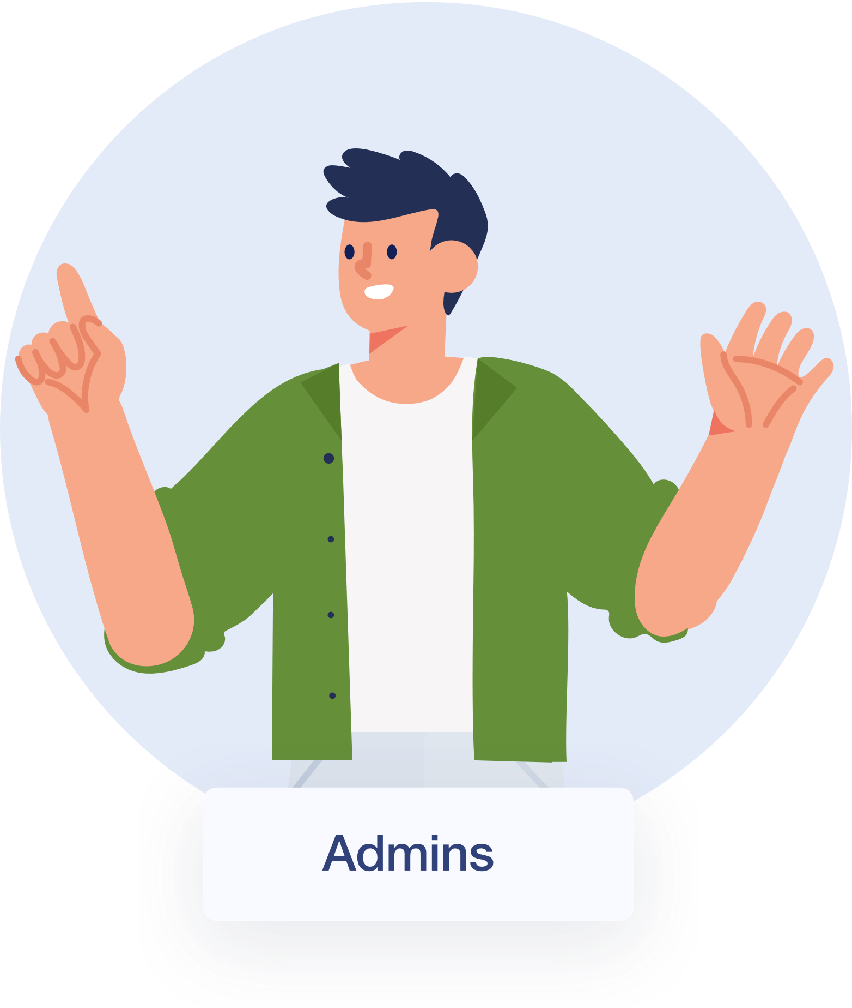



Always up to date on the current project status
Digital process for thesis management
Export results for archiving or accreditation purposes
Minimal administration and maximum overview
Notes:
Study advisors and admins have a lot of students to take care of - but often can’t see student progress on their thesis until they turn it in. Admins don’t know who needs more support or they’re stuck running back and forth coordinating between students and professors.
It can be stressful because it’s up to them to make sure everything is done correctly and on time.
With SuSy, Admins have an overview of what’s actually happening and how everyone is progressing. They can see active projects and pending proposals and follow the progress of each individual student. They can see upcoming deadlines and reach out if they need to.
Because now, they know how and where they need to help so that everything goes smoothly.
SuSy takes the whole thesis process online and allows students to move through it autonomously. It reduces administrative effort by digitising the workflow. Admins can manage the timelines, thesis guidelines, and processes for their programmes.
No more sending out emails full of information – instead it’s all readily available in SuSy.

Slide 10



Our value proposition
Help your entire institution see data and insight about your programmes.
Review and export results for archiving, accreditation, and quality management.
Manage the entire thesis process and create a better experience for everyone.
Notes:
In the big picture, SuSy helps your entire institution see data about your programmes. You can review and export results so that you get the insight and information you need for archiving, accreditation, and quality management.
With SuSy, you can manage the entire thesis process and create a better experience for everyone involved.

Slide 11

Design principles
How we designed SuSy
Notes:
Now I‘d like to tell you a little bit about what went into the design of SuSy – what principles guided us.

Slide 12
Design thinking process
empathise
define
ideate
prototype
test
implement
Notes:
SuSy was created using the design thinking process. For those of you who aren‘t familiar with it, this process has six steps.
Empathise: Understand users and their problems, needs, and processes
Define: Define the scope. What do we want to tackle? Which problems do we want to solve?
Ideate: Generate ideas based on the defined scope
Prototype: Develop a prototype to test the value hypothesis
Test: Test for technically stability, usability, usefulness, and enjoyability
Implement: Launch the feature/ version/ product
This isn’t a linear process. It has a lot of feedback loops where you learn something new and move back to a previous step to improve the result.

Slide 13
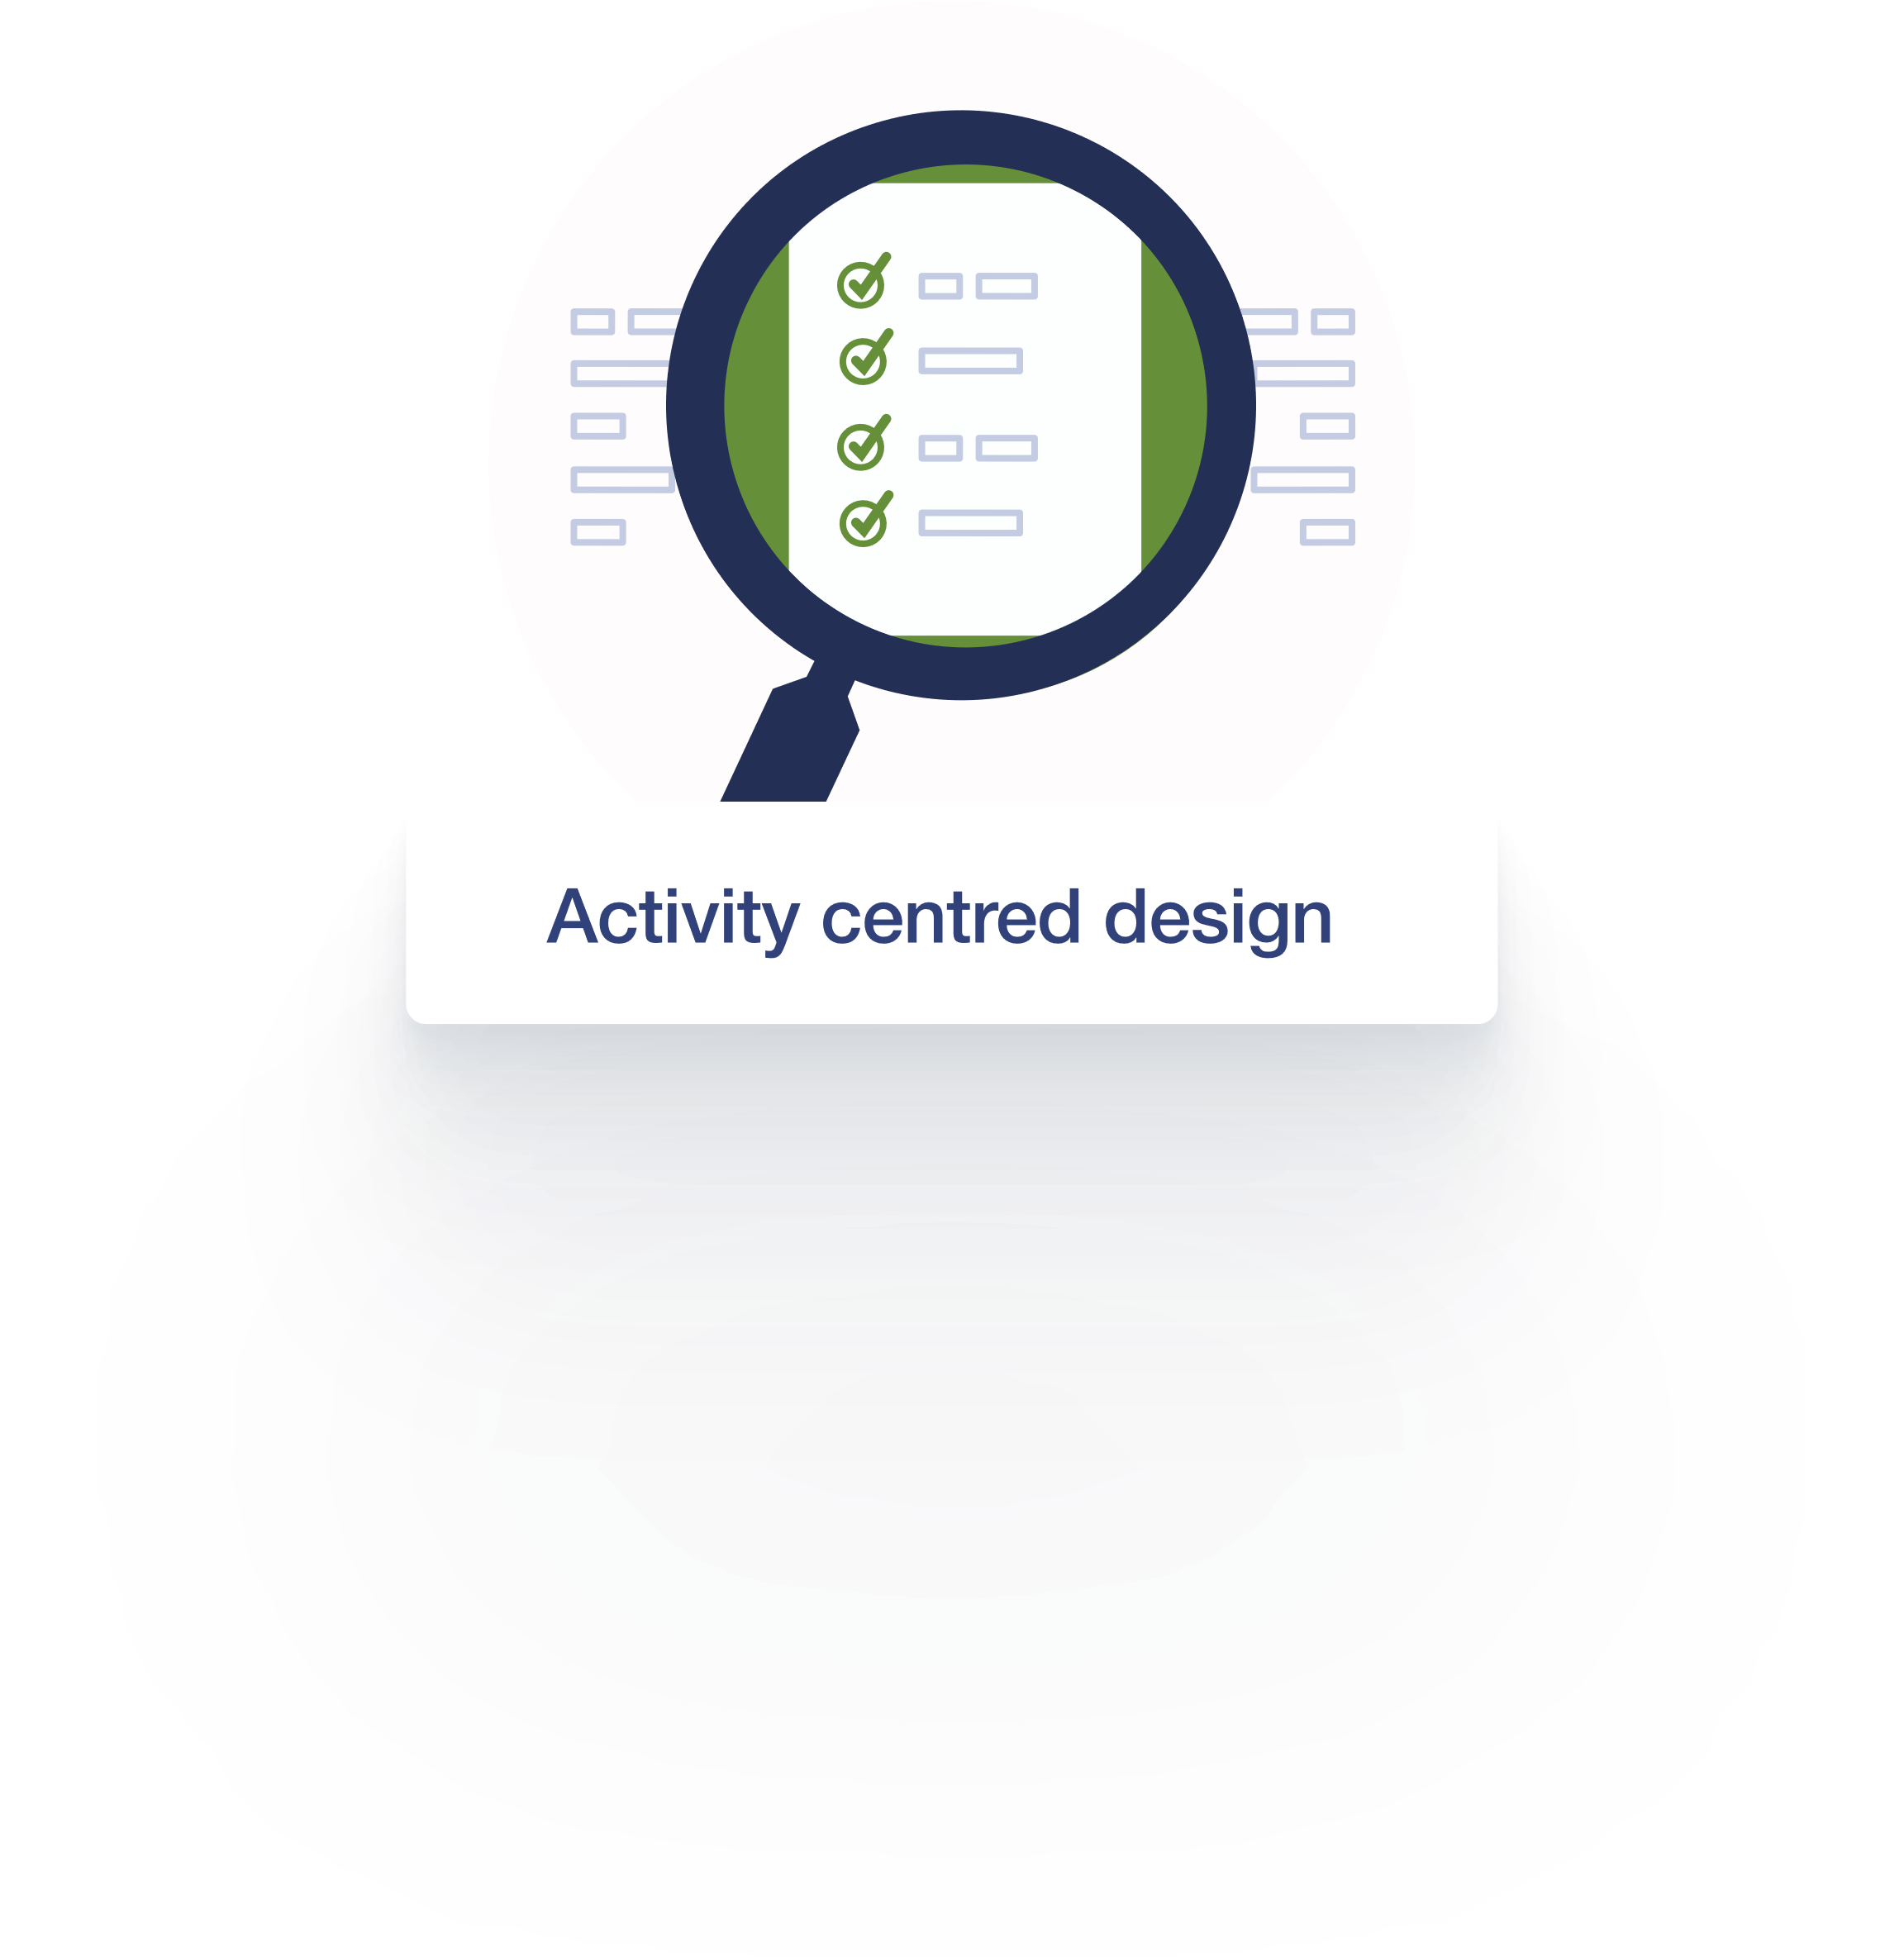
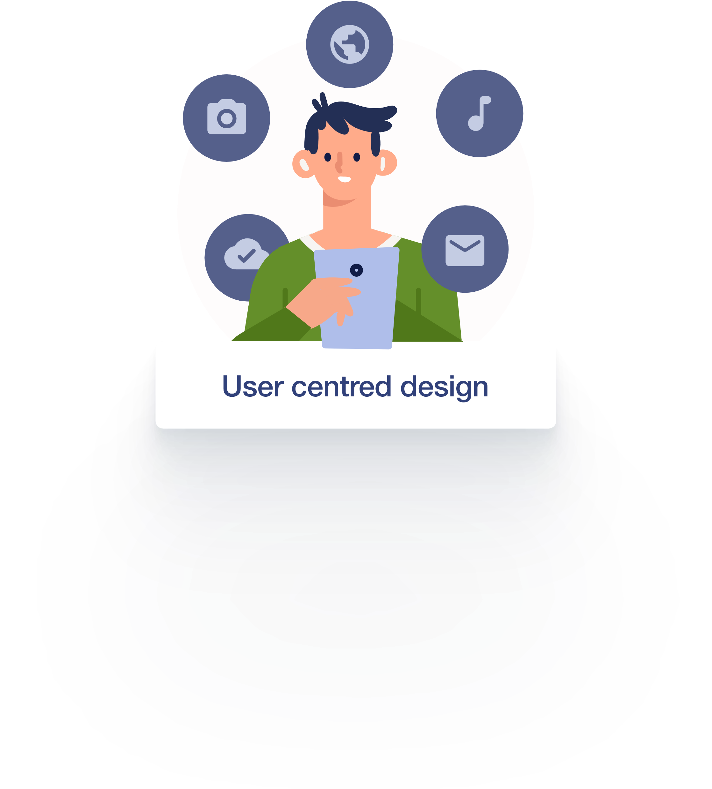
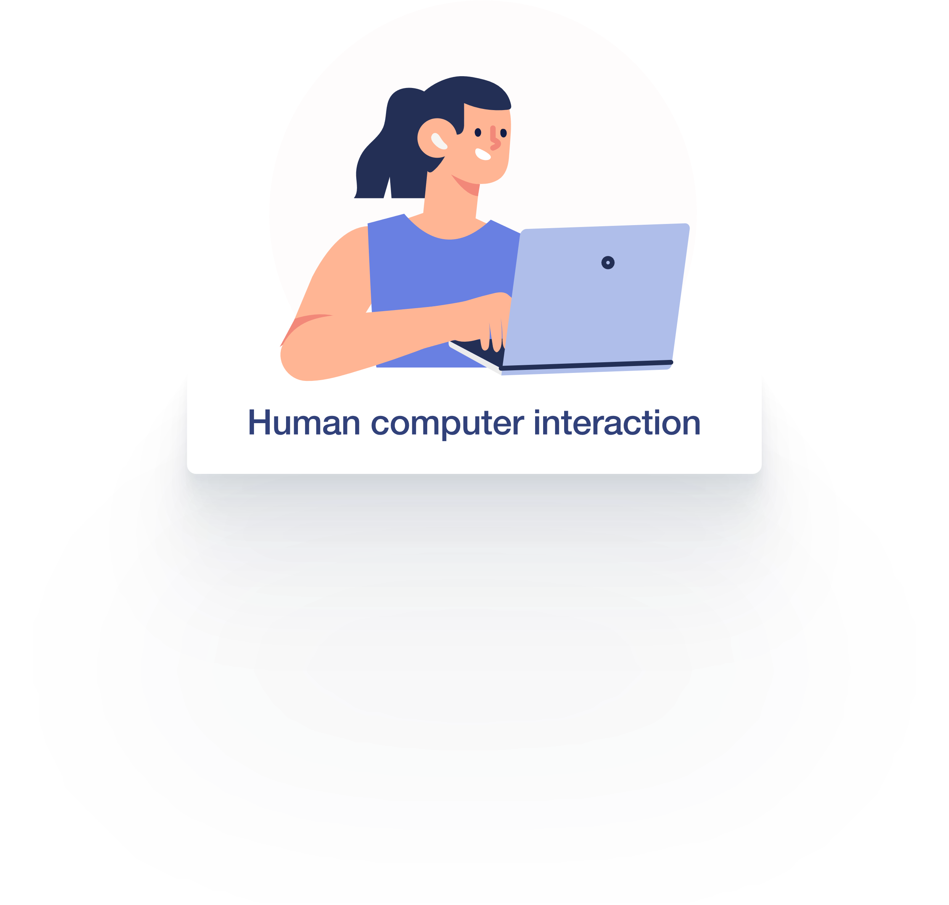

Design principles
Focus on the tasks that need to be done
Create a product that allows users to complete their tasks
Learn from HCI principles to improve the interaction between users and SuSy.
Notes:
We were also guided by several design principles and approaches.
Activity Centered Design is an approach that focuses on the task and not the user. It assumes that the user will adapt to the system. It has some advantages, because focusing on the task ensures the system will be useful. . In reality, this can lead to bad user experience because usability is not considered
That is where User Centered Design comes in. The six steps of the design thinking process - Empathize, Define, Ideate, prototype, Test, Implement - explain the process of UCD. The important part is to define the scope based on the users’ experience and problems, ideate on how to solve those problems (not necessarily how to do a task) and test them with the uses once you have a solution.
Human Computer Interaction researches how humans and computers can work together, and how to improve that relationship. User centred design is a key part of that question. To make sure, that the relationship of human and machine works well, the machine has to be designed in such a way, that the human can understand and use it effectively.
HCI Principles are better understood as guidelines for ideation and development. They give you a good starting point and things to keep in mind that you either really should do, or things that you should avoid.

Slide 14


Design principles
2
1
Simplify the structure of tasks.
3
Use both knowledge in the world and knowledge in the head.
Affordance
4
Get the mappings right.
5
Exploit the power of constraints, both natural and artificial.
7
When all else fails, standardize.
6
Design for error.
From The Design of Everyday Things by Don Norman
Notes:
The seven principles are from Don Norman in his book "design of everyday things" in which he described interaction design.
Use both knowledge in the world and knowledge in the head. Knowledge in the world is information that we can pick up, knowledge in the head are memories. People will adjust their environment to remember information (this can be a notebook or a database, the possibilities are endless). We want to offer tools to offload cognitive functions so the users can focus on their tasks.
People work better, if they have a way to access information in the environment. That way, they don’t have to remember everything, and the recall might actually be faster
2. Simplify the structure of tasks. reduce the needed planning and memory recall.
3. Affordance Signal what parts can be used for what tasks. An object should signal, just by its looks, how it should be used. A mug can be picked up by the handle, and has clear affordance on how to use it. Doors sometimes have bad affordances, since we cant tell if it is push or pull by just looking at them.
4. Get the mappings right. The mental modal needs to align with the design model. This basically means, the user predicts the behaviour of the system and how it will work, and the system should follow that prediction as best as it can.
This is crucial for SuSy, because we are trying to augment an existing process. Therefore, people have already an expectations of how it should work (not necessarily the students, but the admins and supervisors.
5. Exploit the power of constraints, both natural and artificial. Make the correct option the only option to chose.
Create guides of how to do something. We want to help the students to write the best thesis they can, and guide them through the red tape by clearly telling them what they need.
6. Design for error. Provide an „undo“ button whenever it is possible. For the legal process of writitng a thesis, this doesnt really work, but we should provide options in the case student changes their mind, or an admin makes a mistake
7. When all else fails, standardise. If the process is a novel one (there is no mapping available) then it should be standardized so the user only need to learn it once.

Slide 15



General UX pillars
The product should be ...
Usable
Enjoyable
Can the users use the feature/ version/ product?
Does it feel good to use?
Useful
Does it solve the problem it‘s meant to solve?
Notes:
Three user experience pillars governed our design of SuSy and there were three questions we asked ourselves repeatedly along the way.
Is the product usable? Can users actually use it?
Is it useful? Does it solve the problem it’s meant to solve?
Is it enjoyable? Is it fun to use?

Slide 16





Lessons learned
Don‘t be afraid to discard your solution
Implement for your users, not yourself
Always talk to your users
Test, test, test
Notes:
We treat everything as a learning experience, and we’ve learned a lot while working on SuSy.
Don’t be afraid to discard your solution – sometimes you start working on a solution only to realise there’s a better way. It can be hard to walk away from something you’ve spent time and energy on, but it’s necessary to get the best result.
It’s important to remember that you’re creating a solution for your users. That might sound obvious, but it’s not always easy to remember. Don’t think of solutions for you, and never offload complexity onto the user (don’t develop the easy solution, if that means the user will have to do more)
Constantly talk to your users. At the beginning, they are your key to understanding the scope of the system, but also to understanding what pain points you want to fix. After that, they are an invaluable source of feedback.
And of course, test, test, test. Test to check that everything works the way it should. Test whether it actually solves the problem. Test whether it’s useable.
Because doing anything is constant process of learning and improving – we look forward to adding even more lessons learned in the future as we strive towards our goals.

Slide 17
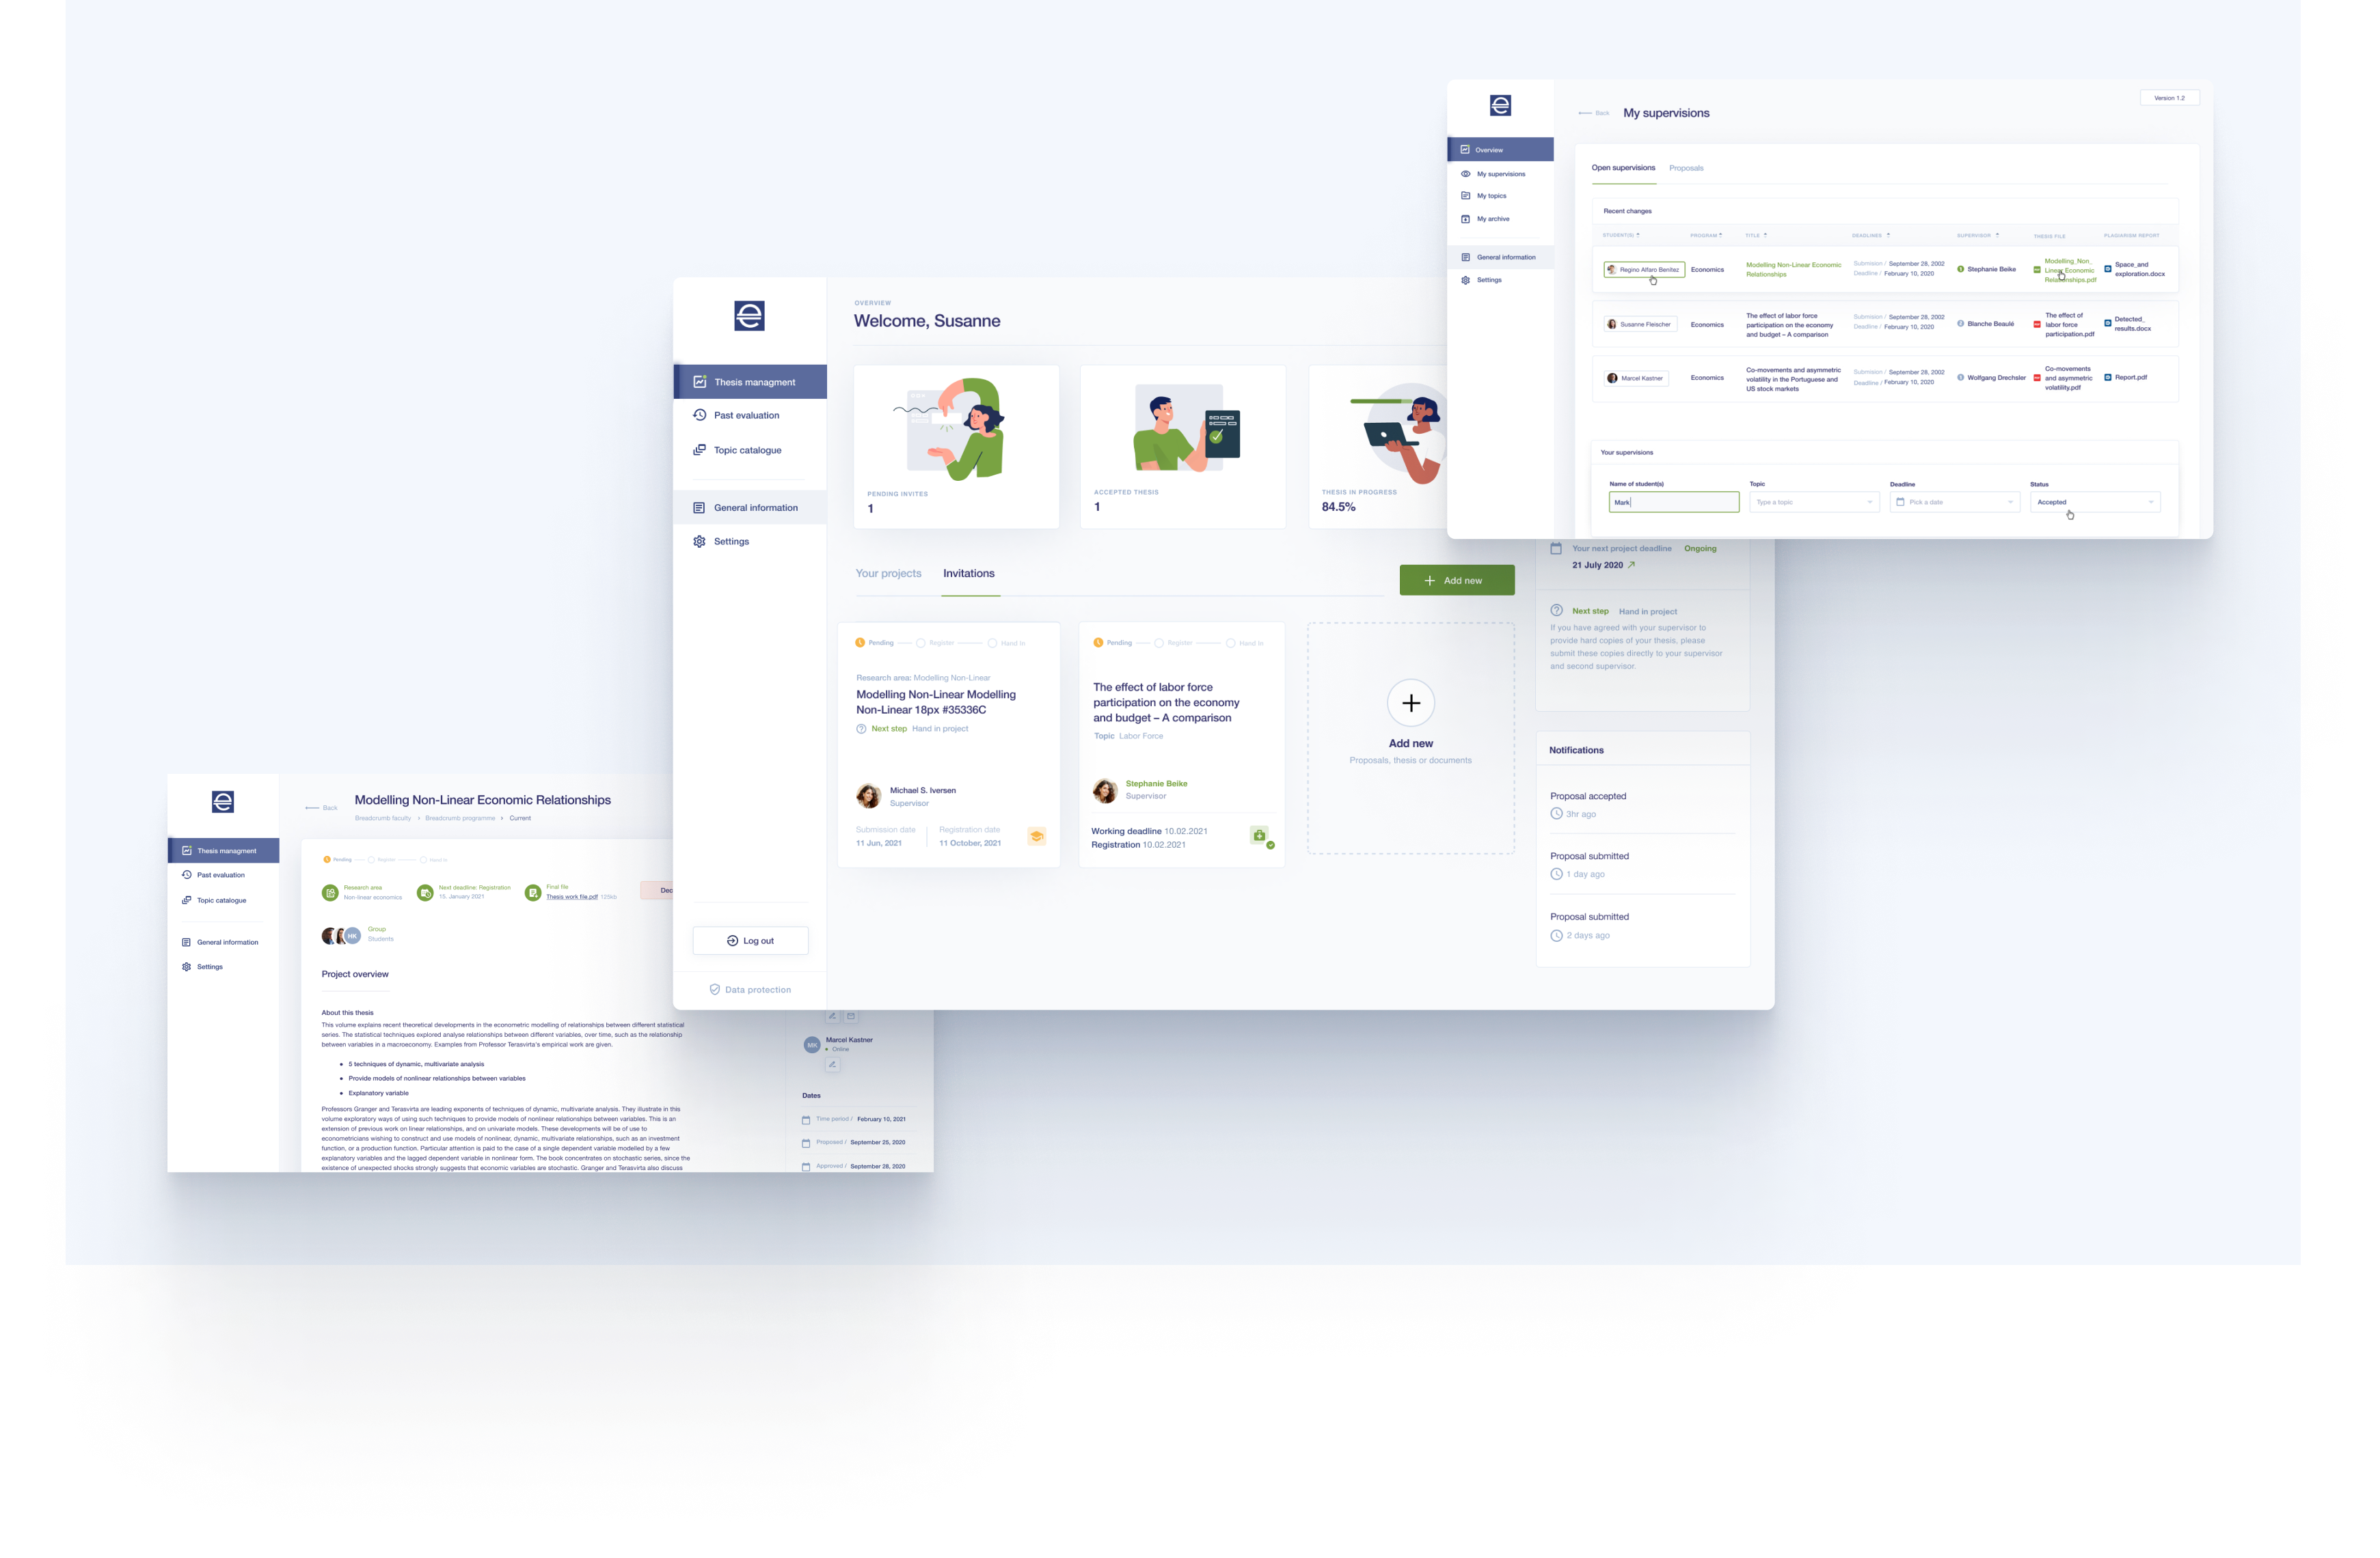
What does SuSy look like?
Notes:
So, what does SuSy actually look like?
Here we see a few screenshots from the system that should give you an impression of the overall look and feel.
Each user type has a dashboard that gives them the most important information at a glance – showing them where they are in the process and what the next step is.
On the (right) we see an overview of a project – where everyone involved can see the details, upcoming deadlines, and contact other users.
On the (left), we see a supervisor‘s overview of their supervisions – where they can see the current status and deadlines for all of their projects.

Slide 18
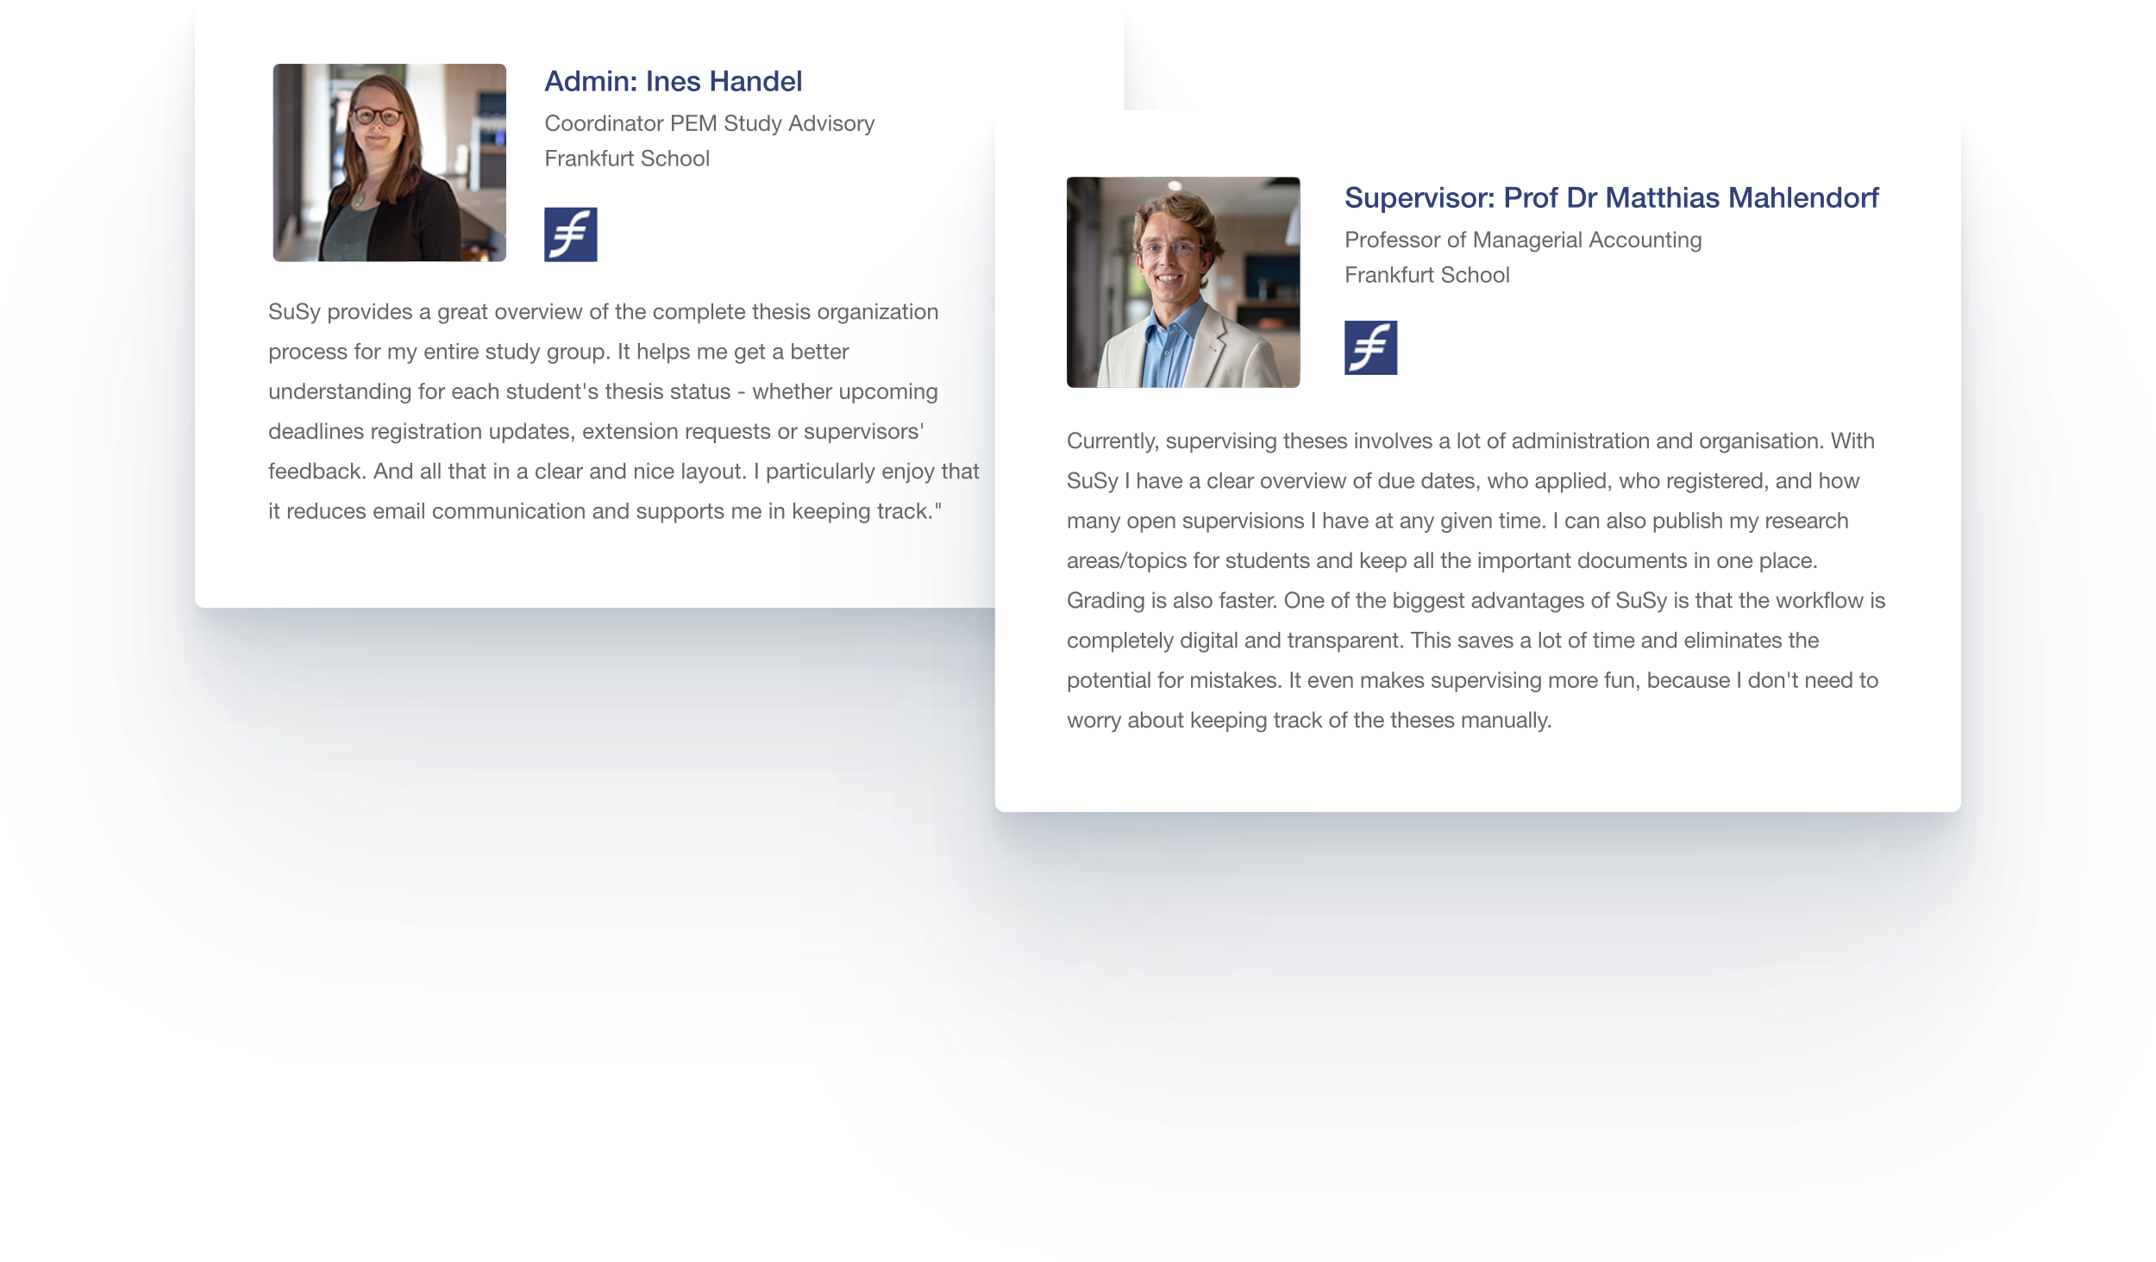
What our customers say
Notes:
Both admins and supervisors who are already using SuSy at our parent company, Frankfurt school, have been very happy with SuSy. Admins appreciate the overview and say SuSy has reduced the number of emails they have to send and helps them keep track of the current status.
Supervisors also praise the overview and like that they can publish their research areas easily and follow the entire workflow in a digital format.

Slide 19
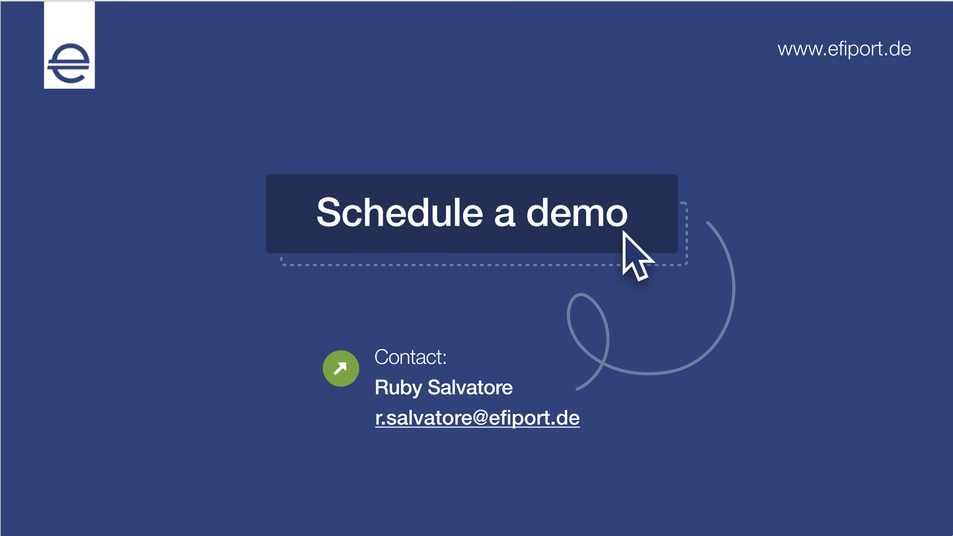
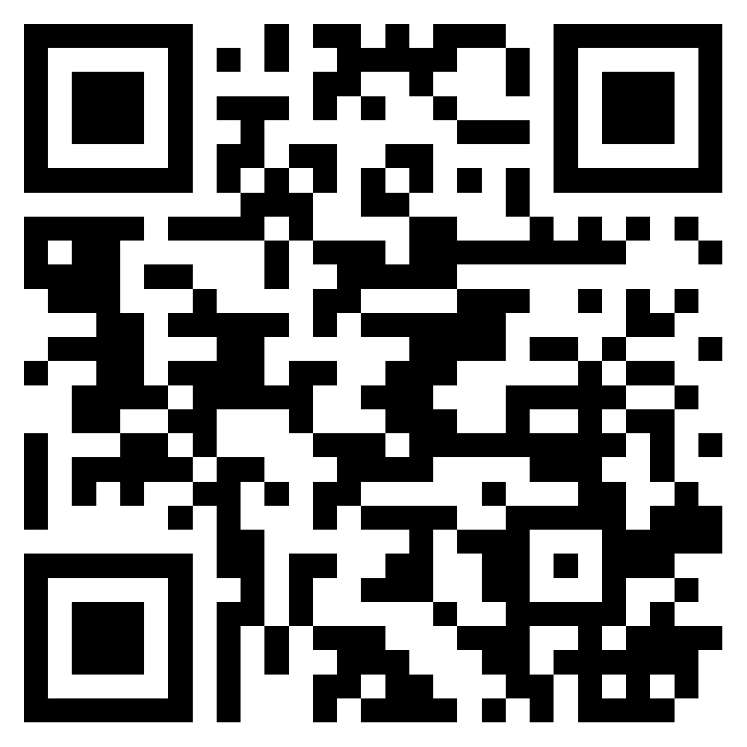
Notes:
Do you want to know more about SuSy?
Please reach out to get updates or participate in user interviews to help us learn more about you and your situation. Or tell us your exciting or traumatic stories involving your thesis.
We’d love to find out where you need help! And learn more about the situations you encounter!

Slide 20


Who we are
Learn more about efiport
Notes:
Now, I‘d like to tell you a bit more about efiport and who we are as a company.

Slide 21
efiport &
Frankfurt School
SUSTAINABLE
LEADING
DYNAMIC
efiport is a subsidiary of Frankfurt School of Finance & Management, a leading private business school that offers top-class degree courses and continuing education options. We work closely with our parent company to provide excellent education opportunities
efiport is an EdTech & eLearning company that sees everyone as a learner. We focus on enabling learning experiences through technology. We research and develop to create innovative solutions for our customers.
AUTHENTIC
PROGRESSIVE
INTERNATIONAL
DETERMINED
SCIENTIFIC
INNOVATIVE
PROFESSIONAL
SOPHISTICATED
COMMUNAL
PRESTIGIOUS
MODERN
COOPERATIVE
ENGAGED
FUTURE ORIENTED
Notes:
efiport is a subsidiary of Frankfurt School of Finance & Management – a leading private busines school in Europe.
We/ efiport are an EdTech & elearning company. We are devoted to being a research and development partner for our customers, we value learning and experimentation highly. We see everyone as a learner and focus on enabling learning experiences through technology.

Slide 22
Our mission & vision
Our vision 01
We see a future in which better feedback and understanding connections enable people to realise their potential, achieve ever better results, and make systematic progress.
Our mission 02
We create and discover connections – between people, data and technology. With immediate, actionable feedback, we help you understand connections and their effects.
Our passion 03
We create smart learning environments for more personalised and targeted learning. By living further education and development ourselves, we prepare for the challenges of the digital future – challenges that our customers will face sooner or later.
Our goal 04
Our goal is to accompany and advise our customers with all of our experience, expertise and passion on their learning path. We work to make learning in digital spaces a sustainable success for a new generation of learners..
Notes:
We see a future in which better feedback and understanding connections enable people to realise their potential, achieve ever better results, and make systematic progress.
To make this future a reality, we create and discover connections – between people, data and technology. With immediate, actionable feedback, we help you understand connections and their effects.

Slide 23



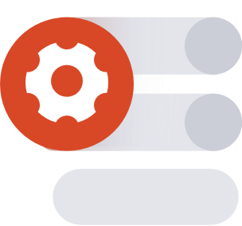
Our products and services
eMTS
SuSy
Learning content
CLM
%
End-to-end outsourcing for the planning, organisation and management of your organisation’s learning and development
An intuitive-to-use online thesis management system
Standard eLearning courses and custom content development
Our campus & learning management system for companies and education providers
Notes:
At efiport, we offer a range of products and services around learning and technology.
You‘ve heard a lot about SuSy today. Now I‘d also like to briefly tell you about our other key products and services.
Managed Training Services – or eMTS – is an end to end outsourcing service that aims to help you plan, organise, and manage your organisation‘s learning and development. From helping you set out a vision, to creating or procuring content, to deploying it on your LMS, we support you every step of the way. What‘s more, we help you get the analytics you need to understand what‘s working and what‘s not.
We offer a wide range of off the shelf and custom eLearning content, both as part of eMTS and otherwise.
And we have our own Campus & Learning management system that includes an LMS and is a back-end data management system.
We‘d love to tell you more about any of these products and services and how they can help you – so please feel free to speak to us about them after the presentation or to reach out later on to learn more.

Slide 24

Facts & figures 2021
2
Locations
40
Employees
2000
Founded
30+
Clients
100,000+
Users
230
Learning Media
FRANKFURT, GERMANY
Headquarters
NOVI SAD, SERBIA
Branch Office
Notes:
Efiport has two offices – one in Frankfurt, and one in Novi Sad, Serbia that we opened a little less than a year ago.
We have more than twenty years of experience, and approximately 40 engaged and enthusiastic employees who value learning for and with our customers.

Slide 25

Our customers
Our customers want to equip their employees with the right skills. We break down the complexity of their learning processes and help them to fully exploit the growth potential of their company.
Notes:
Our customers include universities and other learning institutions as well as companies who want to provide organisational learning to their staff. We‘ve worked with a wide range of institutions – I‘ll show you a few examples on the next slides.
We break down the complexity of learning process to help our customers equip their employees and learners with the right skills so that they can exploit the growth potential of their institution.

Slide 26

Universities and academies
Banking Academy [BdB-Akademie]
Frankfurt School of Finance & Management
Graduate School Rhein-Neckar
Kempten University of Applied Sciences, Professional School of Business & Technology
Neu-Ulm University of Applied Sciences (HNU)
Verband private Hochschulen [Association of Private Universities]
Zeb Business School der Steinbeis-Hochschule Berlin
Centre for Postgraduate Studies at Neu-Ulm University of Applied Sciences [Zentrum für Weiterbildung der Hochschule Neu-Ulm]
…
Notes:
We‘ve worked with universities throughout Germany, including private universities, universities of applied sciences, and other graduate schools.

Slide 27

Companies
Allianz (Insurance)
Commerzbank (Finance)
Deutsche Bank (Finance)
Deutsche Apotheker- und Ärztebank
[German Pharmacists' and Doctors' Bank] (Finance)
HypZert (Academy of German Cooperatives)
ING Diba (Finance)
Zumedu (Health)
Innocorp (Society for Innovative Corporate Management)
Postbank (Finance)
Santander Consumer Bank (Finance)
PriceWaterhouseCoopers International – PWC Rohde & Schwarz (Electronics group)
Verband Deutscher Pfandbriefbanken
[Central Association of the German Credit Industry]
…
Notes:
We‘ve also worked with international companies like Allianz, Commerzbank, Deutsche Bank, and ING Diba. Many of our customers are in the finance industry and we‘ve helped them educate their staff and create exceptional learning experiences.

Slide 28
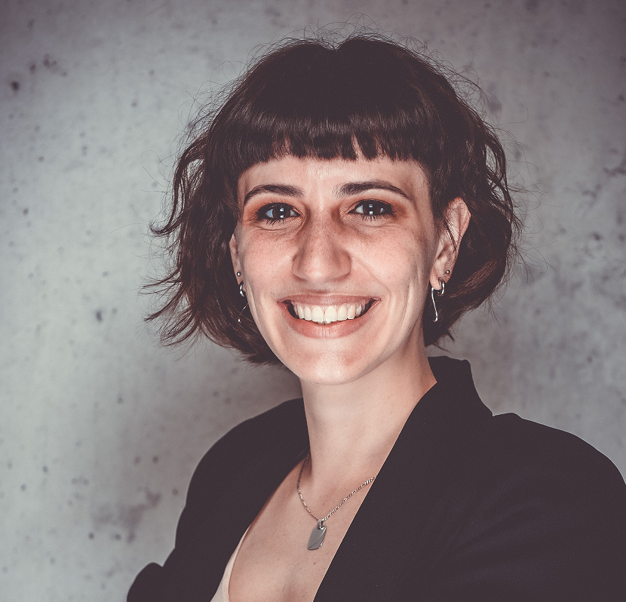
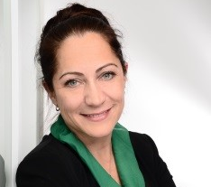
Your efiport partners
Main pointv00
v00
Ruby Salvatore
Business Development Manager
r.salvatore@efiport.de
+49 69 154008 - 711
Manuela Zehe
Director Sales & Marketing
m.zehe@efiport.de
+49 69 154008 - 603
Notes:
We‘d love to hear from you. We‘re always excited to learn about you, your challenges, what you’re doing. Please feel free to send an email or give us a call. We can exchange anytime.
You can reach out to me directly, or to my colleague Manuela Zehe. She’s our Director of Sales & Marketing. She’s also here today!

Slide 29

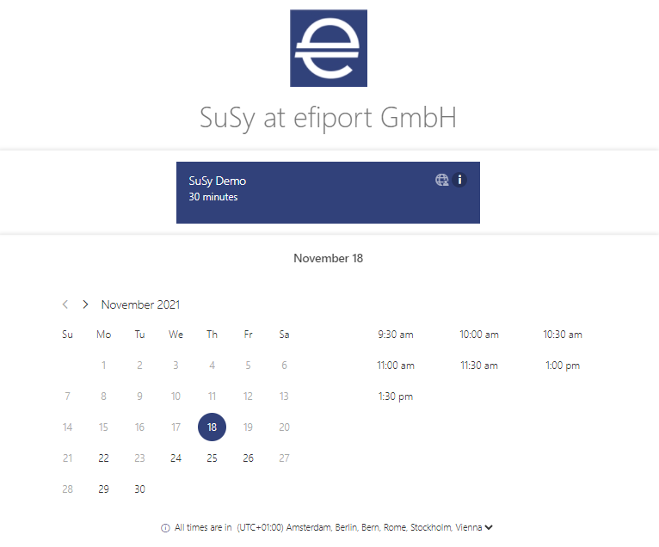





www.efiport.de
linkedin.com/company/efiport
xing.com/companies/efiportgmbh
facebook.com/efiportGmbH
twitter.com/efiport
instagram.com/efiport_gmbh
+49 69 154008 600 | info@efiport.de
Notes:
You can also visit our website or check out our social media to learn more about who we are, what we do, and – of course – about SuSy. You can book an appointment directly on our website, to learn about SuSy or our other products, or just to set up an introductory chat.

Slide 30
THANK YOU
Notes:
So, now I would like to say THANK YOU. Thank you for your time, your attention, your interest. Our goal was to tell you about SuSy, but also to share our enthusiam for learning and learning experiences. I‘d love to hear any questions you have.

Slide 31
Notes:
Do you want to know more about SuSy?
Please reach out to get updates or participate in user interviews to help us learn more about you and your situation. Or tell us your exciting or traumatic stories involving your thesis.
We’d love to find out where you need help! And learn more about the situations you encounter!

Slide 32
Adickesallee 32-34, 60322 Frankfurt am Main
+49 69 154008 - 600
info@efiport.de
Ruby Salvatore
+49 69 154008 - 711
r.salvatore@efiport.de

